Slide 1
Concepts Of Programming Task

Slide 2
What is Functional Programming ?(FP)
Functional Programming is a popular programming paradigm closely linked to computer science's mathematical foundations. While there is no strict definition of what constitutes a functional language, we consider them to be languages that use functions to transform data.

Slide 3
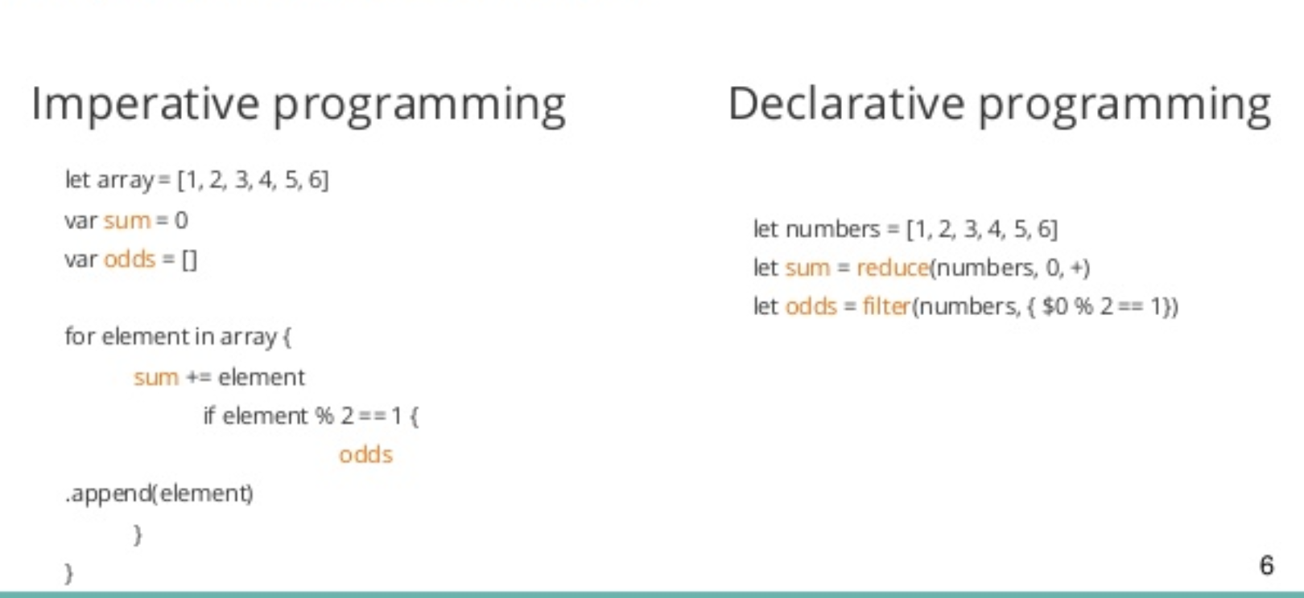
Functional Programming Concepts
Functional languages are declarative languages, they tell the computer what result they want.
Declarative programming is when you write your code in such a way that it describes what you want to do, and not how you want to do it. It is left up to the compiler to figure out the how.
VS

Slide 4
Functional Programming in Python
1.Pure Functions
If you'd like functions to be pure, then do not change the value of the input or any data that exists outside the function's scope.
This makes the function we write much easier to test. As it does not change the state of any variable, we are guaranteed to get the same output every time we run the function with the same input.
def multiply_2_pure(numbers):
new_numbers = []
for n in numbers:
new_numbers.append(n * 2)
return new_numbers
original_numbers = [1, 3, 5, 10]
changed_numbers = multiply_2_pure(original_numbers)
print(original_numbers) # [1, 3, 5, 10]
print(changed_numbers) # [2, 6, 10, 20]

Slide 5
Functional Programming in Python
2.Immutability
data cannot be changed after it is created. Take for example creating a List with 3 items and storing it in a variable my_list. If my_list is immutable, you wouldn't be able to change the individual items. You would have to set my_list to a new List if you'd like to use different values.
Python offers some immutable data types, a popular one being the Tuple. Let's contrast the Tuple to a List, which is mutable:
mutable_collection = ['Tim', 10, [4, 5]]
immutable_collection = ('Tim', 10, [4, 5])
#this is the tuple

Slide 6
Functional Programming in Python
3.Higher Order Functions
functions can accept other functions as parameters and functions can return new functions as output. This allows us to abstract over actions, giving us flexibility in our code's behavior.
def add2(numbers):
new_numbers = []
for n in numbers:
new_numbers.append(n + 2)
return new_numbers
print(add2([23, 88])) # [25, 90]

Slide 7
How we implement FP in our Code?
# 'on_equal':This method calculates the expression present in input field
def on_equal():
try:
result=str(eval(expression)) # 'eval':This function is used to evaluates the string expression directly
except:
result="Math Error"
result_field_data.set(result)
this is the first function
this is the second function
we have implemented the concept of High Order Functions in our source code ,by making the on_equal function return the result of another function which is eval() and the result will be returned and showed on the GUI in the result_field_data entry field

Slide 8
Task GUI
Tkinter Window
input_frame to put entry field inside it
input_field to display the expression
Canvas to display the line
result_field to disply the result
buttons_frame to display buttons inside it
Buttons inside buttons_frame

Slide 9
sources
https://docs.python.org/3/howto/functional.html
Data Visulalization in Python Book -Daniel Nelson
https://stackabuse.com/functional-programming-in-python/
https://realpython.com/python-gui-tkinter/

